Slide 1
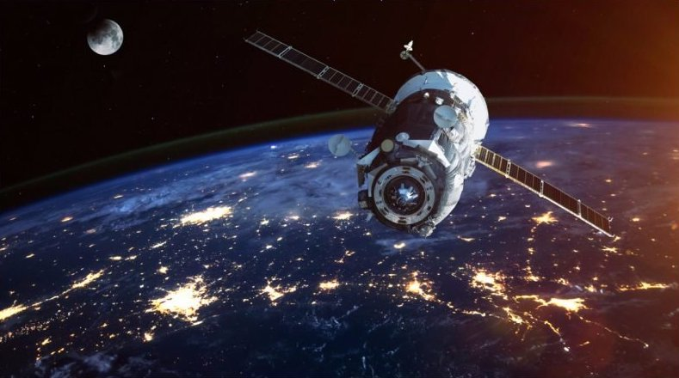
Houston, We Have a Problem
Classifying Satellites and Space Junk
Allen Qu

Slide 2
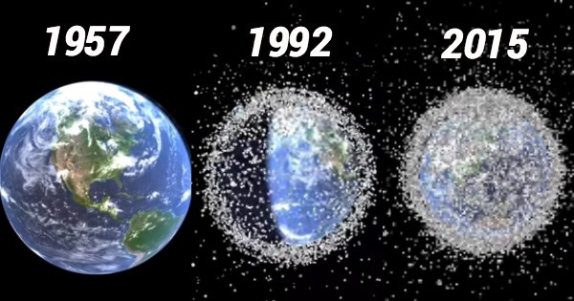
Problem
Kessler Syndrome:
high density of space objects →
collisions → space debris

Slide 3


Data
Dataset with ~2000 active satellites
Dataset with ~19000 objects in space
Combined into one dataset

Slide 4
Data
Features:
ID Number
Country
Launch Date
Period
Inclination
Apogee
Perigee
Radar Cross Section Size

Slide 5
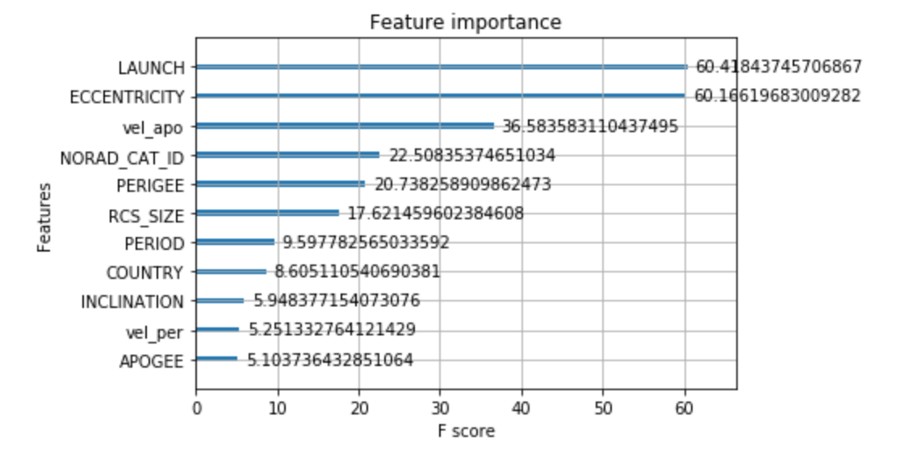
Modeling with XG-Boost
1. Balanced weights of classes (active and other)
2. Added features: Eccentricity, Velocity at Perigee, Velocity at Apogee
3. Stratified K-Fold CV
4. Adjusted Threshold to Optimize F1 Score

Slide 6

Results
Original F1 Score on Train Data: 0.820
F1 Score on Train After Model Tuning: 0.872
F1 Score on Test Data: 0.871
D3 Visualization of Model Predictions
http://0.0.0.0:8000

Slide 7
Appendix
D3.js Example Code for Spinning Globe and Point:
https://gist.github.com/franknoirot/896c8f60338d761753dd0ca98f2a629e

Slide 8
Thank you!

